Slide 1


Practical Mycoplasma control for Asia
Chris Morrow, PhD BVSc
Global Technical Manager, Bioproperties
Associate Professor, University of Melbourne
Poultry Focus, Bangkok,
March 2016

Slide 2
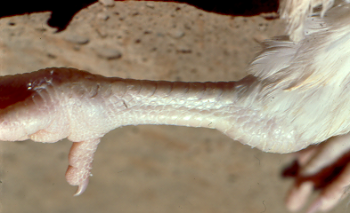
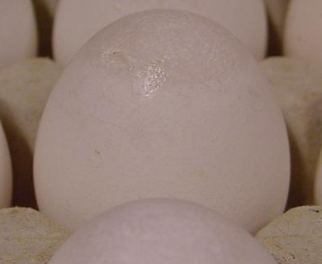
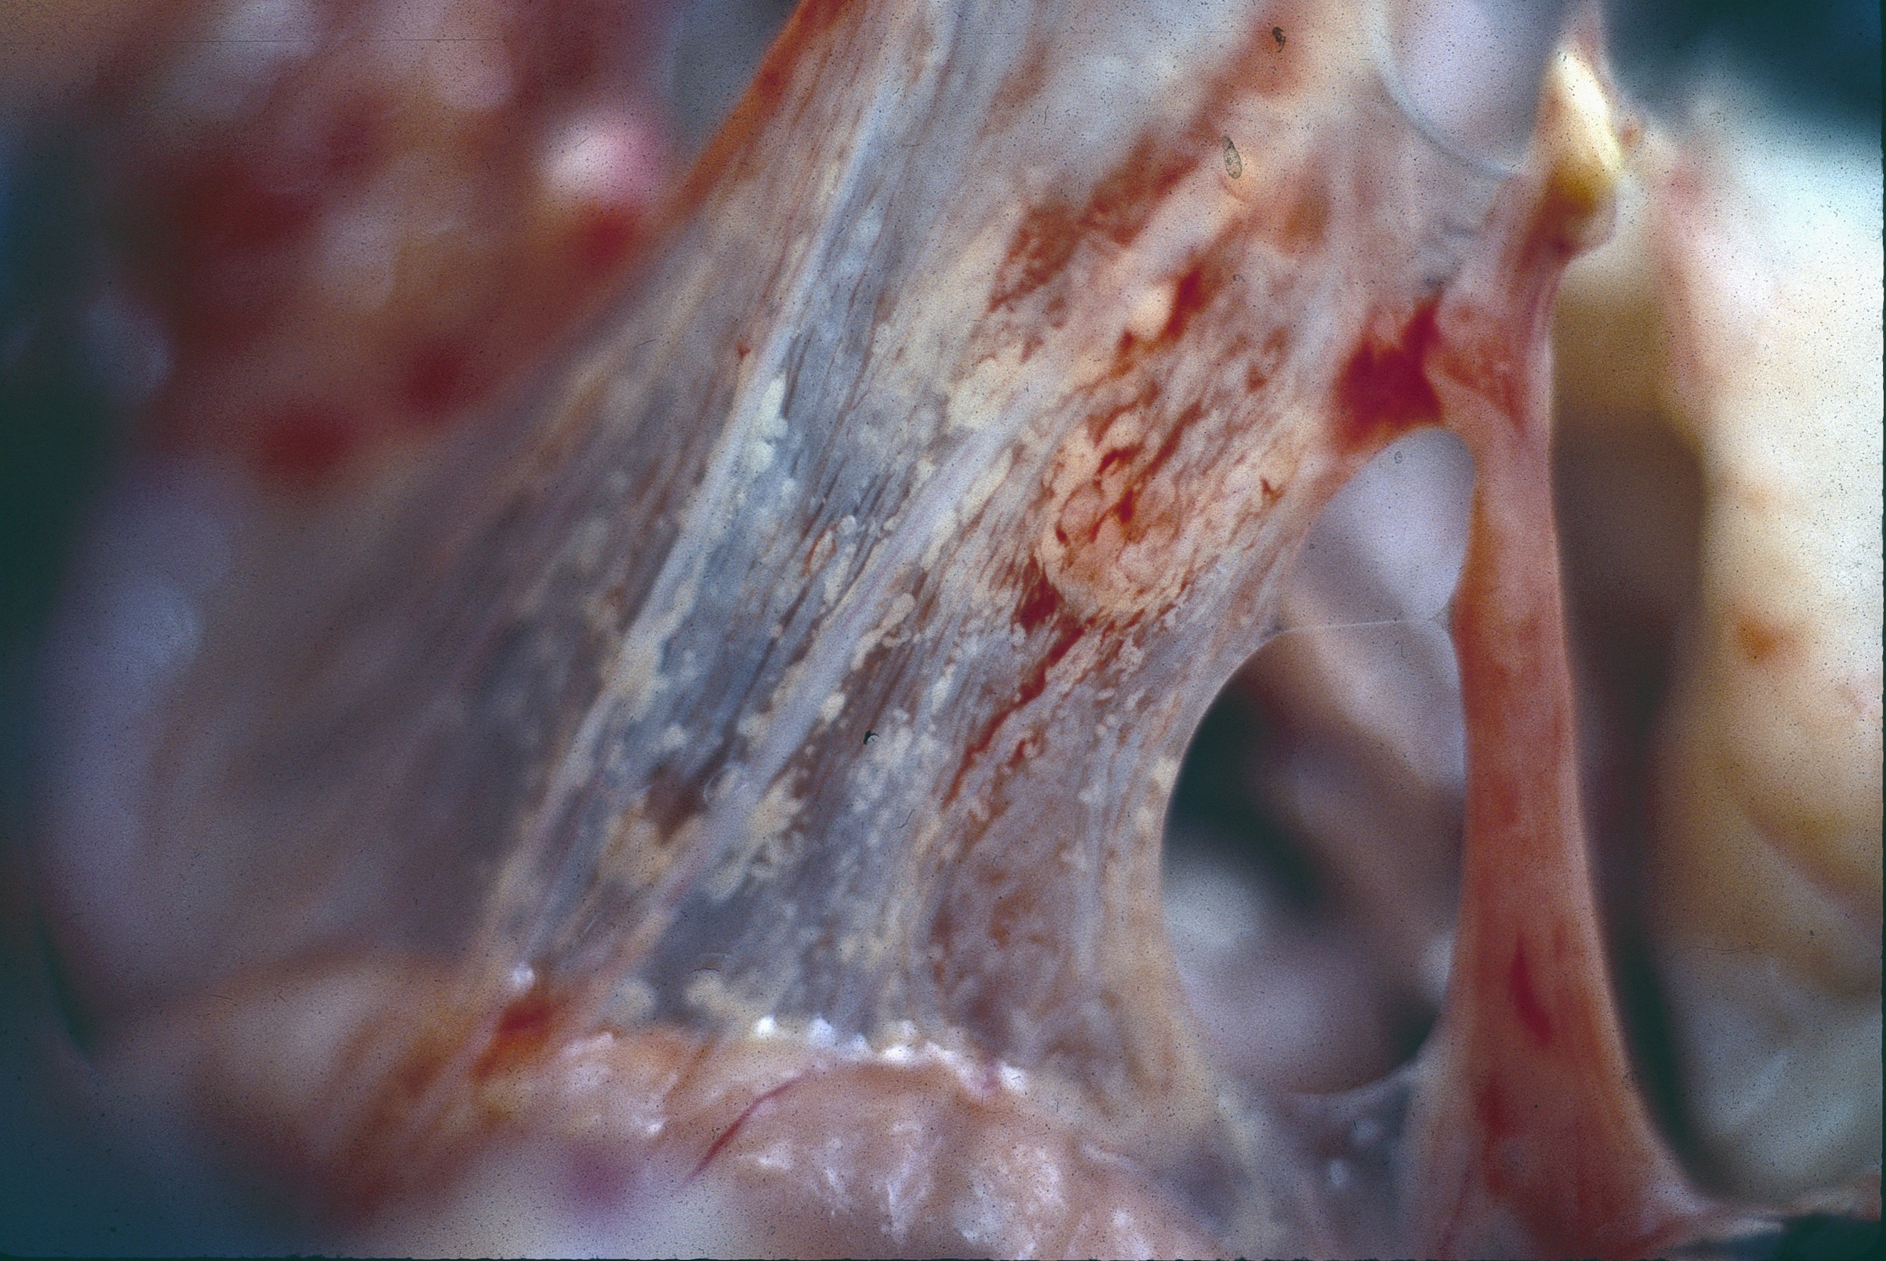
Problems
Biological
  Diseases
    Respiratory, Reproductive (EAA), Systemic (IS)
  Production inefficiencies (Chronic infection)
    Broilers
      Antibiotic dependence
      FCR feed into live weight
    Layers and breeders
      Output
      Antibiotic dependence
      FCR feed into eggs
Commercial
  Export
  Local (especially in non integrated production systems)
    Maternal antibody

Slide 3
Effects in commercial chickens
Parameter | MG infected (strain dependent) | F strain vaccinated (Never used in Breeders in USA) | MS infected (very strain dependent)
Overt respiratory disease | Yes | Yes | Not by itself in lab setting
Layers – chronic effects on egg production | 10 to 20 eggs/hen less than free flocks | 7 eggs less than free flocks (Carpenter et al 1981) | 5 to 10 eggs/hen less than free flocks (3 eggs BB)
Infection in lay | Egg drop | Protected | Egg drop
Hatchability | Increased pips with airsacculitis | Vertical transmission | Variable increased pips with airsacculitis
FCR of egg production | Unknown but probable | Unknown but probable | 4% more seen in vaccine responses assessments
Progeny CRD and meat FCR | Yes | Yes especially with LaSota | Yes in synergistic situations
Infectious synovitis | Rarely | No | Some strains
Peritonitis | Yes | Unlikely | Yes
EAA | No | No | Yes
adapted from Stipkovits and Kempf 1996

Slide 4
Effects in commercial chickens
Parameter | MG infected (strain dependent) | F strain vaccinated (Never used in Breeders in USA) | MS infected (very strain dependent)
Overt respiratory disease | Yes | Yes | Not by itself in lab setting
Layers – chronic effects on egg production | 10 to 20 eggs/hen less than free flocks | 7 eggs less than free flocks (Carpenter et al 1981) | 5 to 10 eggs/hen less than free flocks (3 eggs BB)
Infection in lay | Egg drop | Protected | Egg drop
Hatchability | Increased pips with airsacculitis | Vertical transmission | Variable increased pips with airsacculitis
FCR of egg production | Unknown but probable | Unknown but probable | 4% more seen in vaccine responses assessments
Progeny CRD and meat FCR | Yes | Yes especially with LaSota | Yes in synergistic situations
Infectious synovitis | Rarely | No | Some strains
Peritonitis | Yes | Unlikely | Yes
EAA | No | No | Yes
adapted from Stipkovits and Kempf 1996

Slide 5
Mycoplasma must be controlled
Antibiotic
Live
Vaccines
Freedom (Kill Positives)
  Susceptible population
Antibiotics
  Acquired resistance
  Cost
Killed vaccines
  Humoral antibody
Live vaccines
  Mucosal immunity
Combinations
  Incompatibilities
Breeders, Layers
✓
GPs, Broilers
Killed vaccines
Freedom

Slide 6
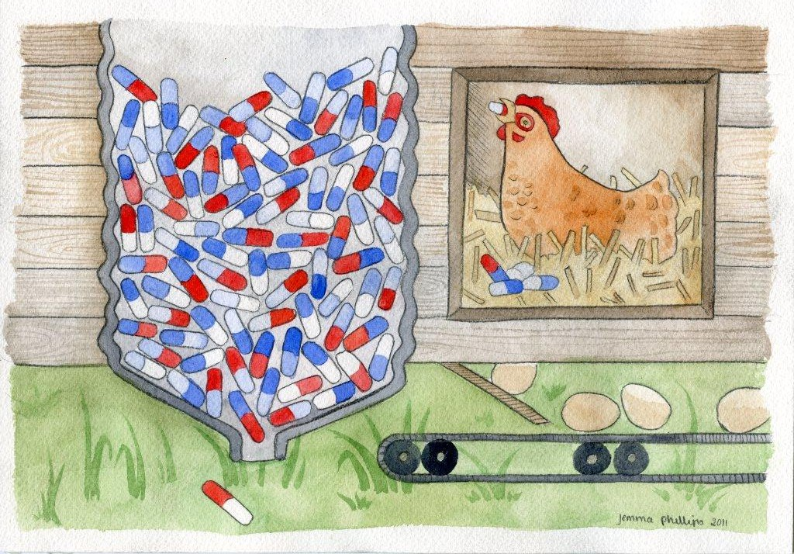
Antibiotic usage creates resistance
Not sustainable
  The more you use the more you lose
  May be in non target organisms
Customer don’t wont
  Frenzy over Colistin resistance emergence
  Technical issues are not important anymore.
  The battle is lost.

Slide 7
Antibiotic Free Definition (Broilers)
Region | Therapeutics | Growth promoters | Ionophores | Comment
USA | OK but no longer antibiotic free | No | No – considered antibiotic | Coccidiosis vaccination or chemicals in broilers & Mycoplasma Freedom
EU | Large variation in use between countries | No | No problem | MS control is important
ROW | No definition | Variable | No problem | Mycoplasma control by antibiotics in some areas
Australia | OK but no antibiotic free (except organic) | Legal but certain customers restrict use | No problem | Mycoplasma control by live vaccination

Slide 8
Kinetics of Vaccine strain infection and development of immunity (Concept)
Wild type

Slide 9
Kinetics of Vaccine strain infection and development of immunity (concept)

Slide 10
Kinetics of Vaccine strain infection and development of immunity + Antibiotic

Slide 11
Kinetics of Vaccine strain infection and development of immunity + Antibiotics

Slide 12
Kinetics of Vaccine strain infection and development of immunity + Antibiotics II

Slide 13
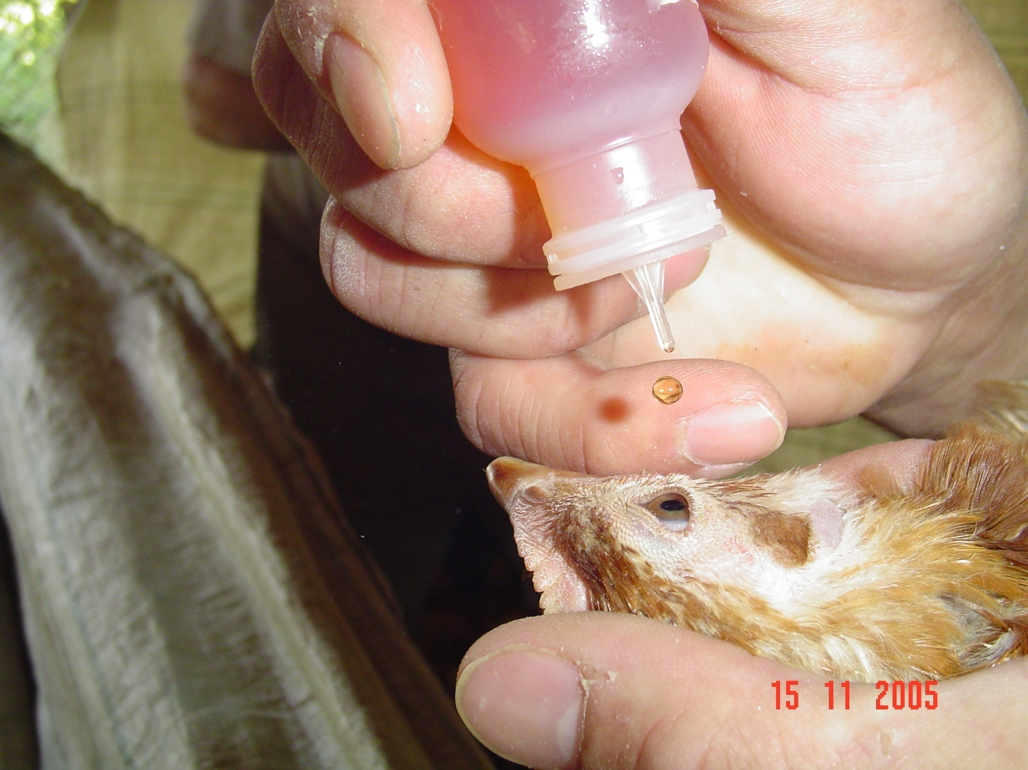
Mucosal Immunity
Short duration
  Like Coccidial vaccines
Maintenance requires regular stimulation
Not always parallel to humoral antibody
Live vaccine colonizing a mucosal site for life is the perfect solution
  Affects field strain pops.
  Must vaccinate before infected.

Slide 14
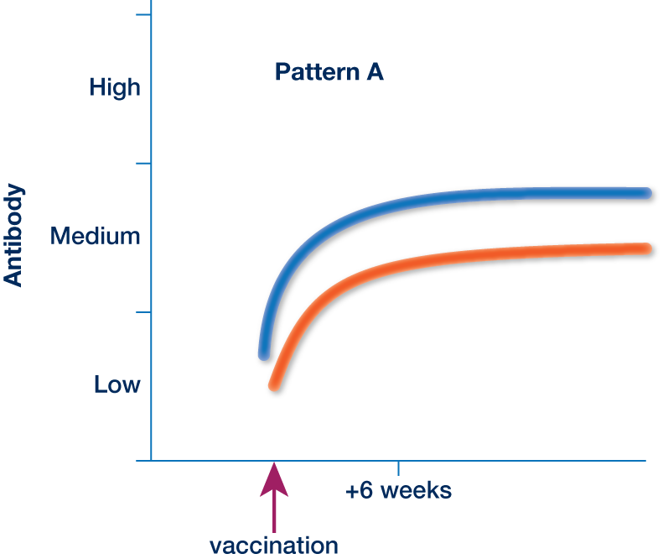
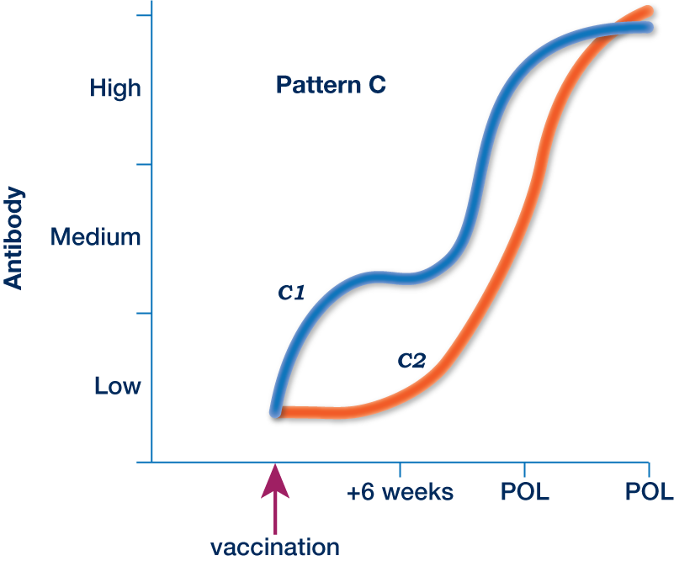
Normal Antibody patterns in ts11/MSH vaccinated flocks

Slide 15
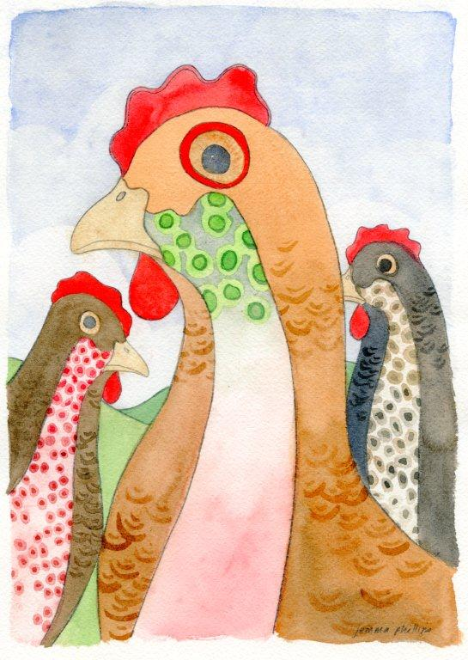
Are all live MG & MS vaccines the same?
No – variation in
  Price
    Price of Vaccine
    Cost of Administration
  Mode of administration
  Presentation, Storage, and cold chain dependence
  Strain dependent properties
    Horizontal transmission
    Vertical transmission
    Residual virulence and Reversion to virulence
    Immunogenicity/Protection
    Antibiotic sensitivity?
    Reason for attenuation
Variation in
  Humoral antibody response
  Technical tools to support product
  Ability to assess protection and vaccine administration in non-specialist laboratories

Slide 16
Indonesia: 2 year result in integration
Parmeter | Before intervention (F + Antibiotic) | After (MSH and ts-11) | Comment
Disease | Clinical respiratory disease | No respiratory signs Less peritonitis | Better livability after vaccination
Saleable DOC | 140 Chicks | 162 Chicks | 15 chicks more than SE Asia Cobb average
Feed per chick | 325g/Chick | 285g/Chick Now getting 280g | From beginning of production.
Hatchability | 89% peak 84.2% average | 92% peak with 89% average
Airsacculitis in pips | >35% | <20% | Good hatchability now
Antibiotics | Tylosin @ six weeks in lay | None | Some at placement
DOC quality |  | Improved | Less customer complaints - Options

Slide 17
Indonesia: Cost Benefit (U$D)
Treatment |  | Before (F + Antibiotic) | Vaccination (MSH and ts-11)
Cost of antibiotics |  | $100K/year (800K Cobb hens) | $0
Cost of vaccine + Admin |  | 7c for F strain + 3c by eye drop | 25-30c per hen MSH and ts-11 by eye drop
Extra production |  |  | +22 extra chicks per hen
Feed (FCR eggs) |  |  | 40g less feed per chick (-15%)
 |  | Respiratory disease | No respiratory disease Less peritonitis in lay
Calculation |  |  | per Hen Profit (No broiler effects)
Extra Revenue | Chicks | 25-50c sale price × 22 chicks | + $5.5 to $11.00 per hen
Extra Cost | Feed | (70c per kg × 0.67 kg/hen) [162 × 285-140 × 325 g] | +$0.47 per hen
Cost Saving | Antibiotics | $100K/800K hens | + $0.16 per hen
Extra Cost | Vaccine | (28c – 10c) per hen | − $0.18 per hen
 |  | Total Extra profit | + $5.95 to $11.45 per Hen

Slide 18
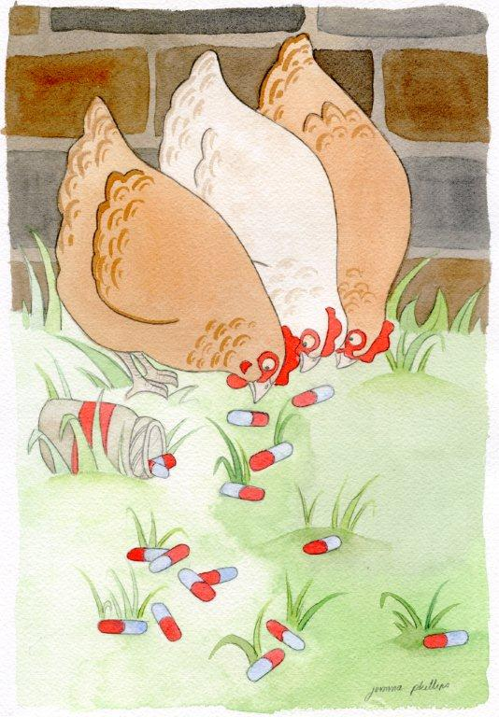
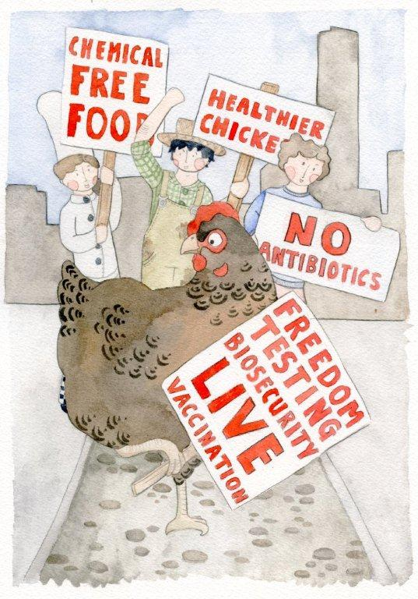
Another way
Live vaccines
  Breeders
  Layers
Forget MG and MS

